Slide 1

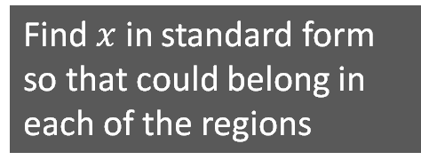

$$x>2.3×{10}^{−3}$$
$$x<2.3×{10}^{−2}$$
A
B
C
D
If you think a region is impossible to fill, convince me why!
Find $x$ in standard form so that could belong in each of the regions

Slide 2



$$x>2.3×{10}^{−3}$$
$$x<2.3×{10}^{−2}$$
A
B
D
If you think a region is impossible to fill, convince me why!
G
E
F
H
C
Think of any number that could belong in each of the regions
$$a×{10}^{−4}$$

